Slide 1



Whitefish Bay Recreation and Community Education
Status Update: 2014-2015
October 7, 2015

Slide 2
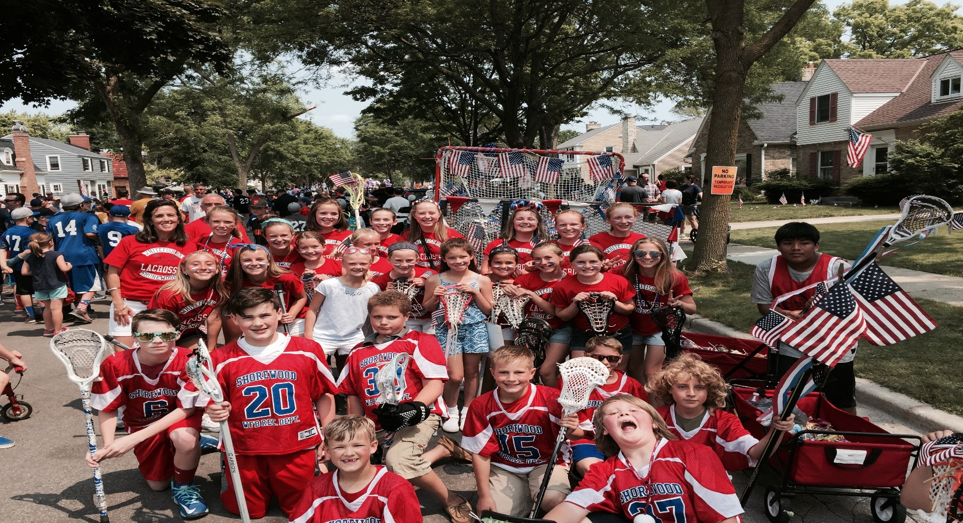
July 1, 2014-June 30, 2015
12,734 Total Participants
1,938 sections of programs offered
4.4% cancelled

Slide 3

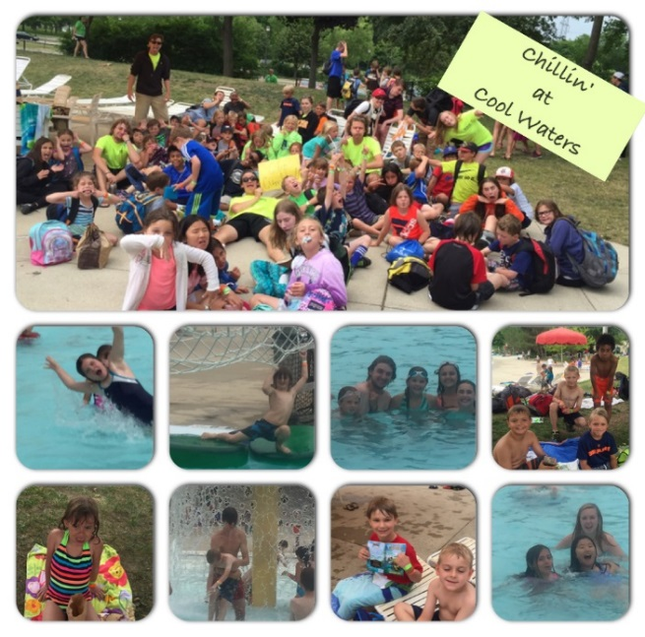
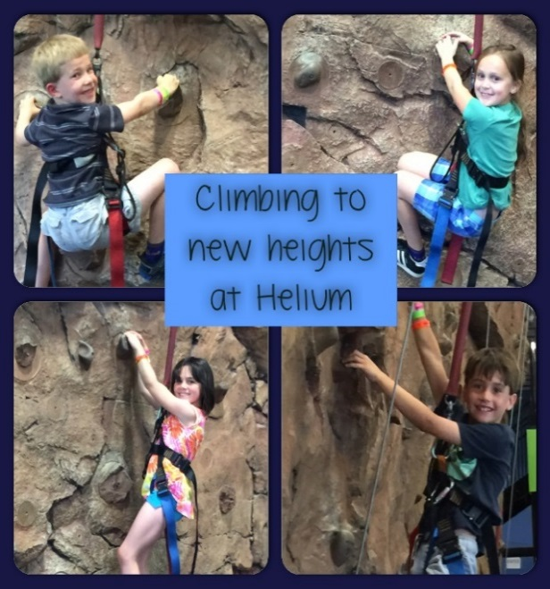
Participation Data Highlights
Summer 2015
Total Enrollees 8,100
Resident Count 7,337 Non-Resident Count 763
842 sections of programming
*Largest age group served 0-9 years 4,271

Slide 4

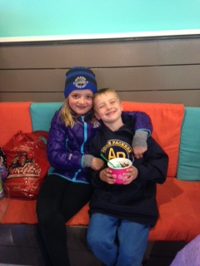
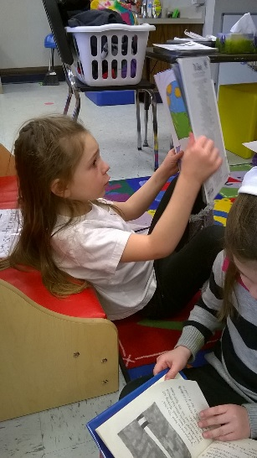
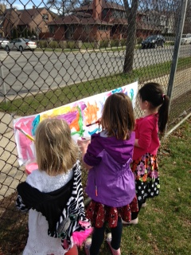
Children enrolled Richards 83 (105) Cumberland 83 (83)
Current student: staff ratios
Grades 1-5: Cumberland 1:10/1:12 Richards 1:15/1:16
Grades K4/K5: 1:12 or under
* All under state recommended ratios
Family Fun Nights- Chili Night, Yo-Daddy, Taco Bar & Karaoke,
Bingo Night
Participated in the Kohl’s Field Trip Grant Program and offered
FREE fieldtrips on select School Days Out days.
The mission of the before and after school program is to provide high quality programming in collaboration with community agencies, parents, district staff and faculty.

Slide 5
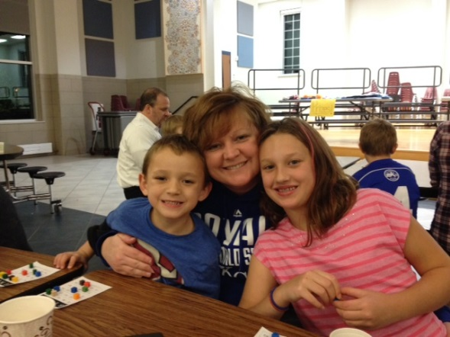
Parent Satisfaction Survey Results
Average Score out of 5
Parts of Day(overall satisfaction for care given) 4.6
School Resources/Linkages 3.67
Overall Impressions 4.32
Parent Communication 4.22
What are Families Saying?
“Great Job! Wonderful caring, & fun staff. Keep up the good work!”
“This has been a wonderful before school program for my daughter! Thank You!”
“The quality of care is outstanding, the staff is very professional and on top of the care needed for each child.”
“Connects has far exceeded our expectations. Our daughter loves it!”
“THANKS for ALL that you do for our children and US! You are appreciated more than you know!”
“Great job by the team there-truly feel it has been the most beneficial area of development for our son this year. Well Done.”

Slide 6

2014-2015 From a Technical to Formal Rating
Worked with a Technical Consultant from September thru March to provide staff with the support and resources needed to prepare for the rating.
In April of 2015, DHFS sent a Youngstar Formal Rater to spend two days at each site observing and evaluating. The rater came unannounced and spent 8 hours total at each site.
The SACERS and ECERS Assessment Tools were used along with the Youngstar Eligibility Requirements.

Slide 7
Connects Formal Rating for 2014-2015
4 star quality rating
Cumberland
Provider Education & Training 10/15
Learning Environment & Curriculum 6/13
Business & Professional Practices 6/7
Health & Wellness 2/5
24/40
Richards
Provider Education & Training 13/15
Learning Environment & Curriculum 7/13
Business & Professional Practices 6/7
Health & Wellness 1/5
27/40

Slide 8
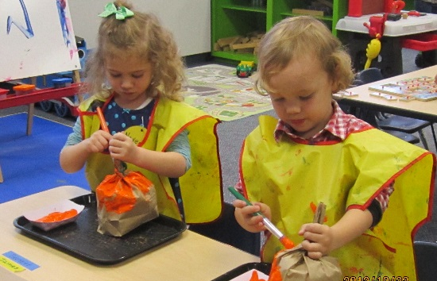

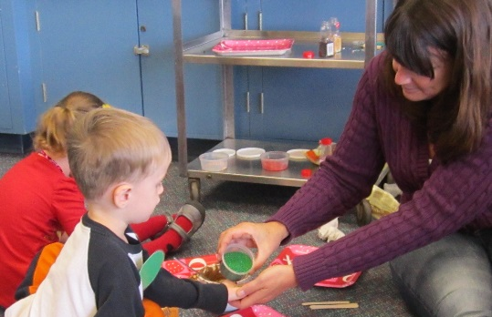
An exceptional place for young hearts and young minds
The Growth of Lydell Preschool
2008 Program opened with 1 class of 16 offered on M, W, F
2009 added a T,TH program with 12 students
2012 added a Toddler program with 12 students on M,W and T, TH
2015 integrated the District’s Early Childhood program that was currently running at a Preschool out of district.
*5 Early Childhood students are integrated into the preschool classroom setting and receiving individual therapies both within the classroom setting, small group and 1:1. The EC students are in the classroom two days week and are working in a small group one day a week with the Special Education Teacher and Aide. It is anticipated that 2-3 EC students will join before the years end.

